Slide 1

Security Benefit Financial Essentials
SECURITY BENEFIT FINANCIAL ESSENTIALS
2021/02/04
SAVING AND PLANNING WORKSHOP – New Jersey
Notes:
[Welcome from presenter]
Thank you for attending today’s Financial Essentials workshop that’s specifically designed and developed for you by Security Benefit.

Slide 2
Agenda
Your Options for Retirement
Why it Matters
How to Take Action
Notes:
Welcome to the workshop!

Slide 3
Your Options for Retirement

Slide 4
Social Security
YOUR OPTIONS FOR RETIREMENT
Overview
  Mandatory federal program that promises a retirement benefit at a certain age.
Full vs Partial Benefit
  Depending on when you begin taking Social Security, you may not receive the highest amount possible.
Future Uncertain
  In 2021, the total cost of Social Security is projected to exceed it’s total income (including interest) for the first time since 1982. Changes must happen to prevent insolvency sooner or later.
Source: Social Security Administration, “Summary of 2020 Annual Reports,” http://www.ssa.gov/oact/TRSUM/index.html

Slide 5
Social Security
YOUR OPTIONS FOR RETIREMENT
Full retirement age
If you were born … | And you start taking Social Security at age …
 | 62 | 63 | 64 | 65 | 66 | 67 | 68 | 69 | 70*
Before 1937 | 80.0% | 86.7% | 93.3% | 100% | 105.5-106% | 111-112% | 116.5-118% | 122-124% | 127.5-130%
1938 – 42 | 75-80% | 80-86% | 86-93% | 93-100% | 106.5-107.5% | 113-115% | 119.5-122.5% | 126-130% | 132.5-137.5%
1943 – 54 | 75.0% | 80.0% | 86.7% | 93.3% | 100% | 108% | 116% | 124% | 132%
1955 – 59 | 70-75% | 75-80% | 80-86% | 86-93% | 93-100% | 101.3-106.7% | 109.3-114.7% | 117.3-122.7% | 125.3-130.7%
1960 + | 70.0% | 75.0% | 80.0% | 86.7% | 93.3% | 100% | 108% | 116% | 124%
 | You are eligible for this percentage of your “full” benefit.
* When you reach age 70, your monthly benefit stops increasing even if you continue to delay taking benefits.
Once you begin taking Social Security, your benefit is locked in. It does not increase as you age.
Note: The government can change these benefit levels/amounts at any time for future retirees.
Source: Social Security Administration, www.ssa.gov

Slide 6
State Pension
YOUR OPTIONS FOR RETIREMENT
Overview
  State program for state employees that guarantees a certain benefit based on salary and years of service
New workers receive less benefit
  As more workers enter the system, newer and younger workers are typically seeing less benefits
Subject to state control
  The state can choose to make changes at any time

Slide 7
State Pension – New Jersey Teachers’ Pension and Annuity Fund
YOUR OPTIONS FOR RETIREMENT
Benefit Tiers
Enrollment Date | Tier | Retirement Age (Minimum) | Benefit Factor | Final Average Salary (FAS)
Prior to July 1, 2007 | 1 | 60 | 55 | Highest 3 yrs
7/1/2007 – 11/1/2008 | 2 | 60 | 55 | Highest 3 yrs
11/2/2008 – 5/21/2010 | 3 | 62 | 55 | Highest 3 yrs
5/22/2010 – 6/27/2011 | 4 | 62 | 60 | Highest 5 yrs
After June 28, 2011 | 5 | 65 | 60 | Highest 5 yrs
Benefit Formula | Example
(Years of Service/Benefit Factor) x FAS | (30 Years of Service/60) x $60,000 = $30,000 per year
Source: TPAF Member Guidebook, June 2018 - https://www.state.nj.us/treasury/pensions/documents/guidebooks/tpafbook.pdf
Notes:
This is quick summary of the pension tiers for new employees and those that are just beginning their careers in the education system. A pension is still one of the best benefits you have as an educator, because it provides income in retirement throughout your lifetime. However, the amount of that benefit has changed for those that are new to the system. For those who have entered the system in the last 5-6 years, your pension benefit will be very different than your peers who have worked longer.
If you began working in a school district AFTER July 1, 2007 – you will be in a different tier – depending on WHEN you actually began working and enrolled. This table shows the minimum retirement age for each tier, however you may be eligible to retire earlier. But your benefit may be reduced by 1-3% for EACH year under the minimum retirement age.
For example, if you were in tier 5 and decided to retire at age 60, your pension benefit would be reduced by as much as 15%.
[Walk through the example.]

Slide 8
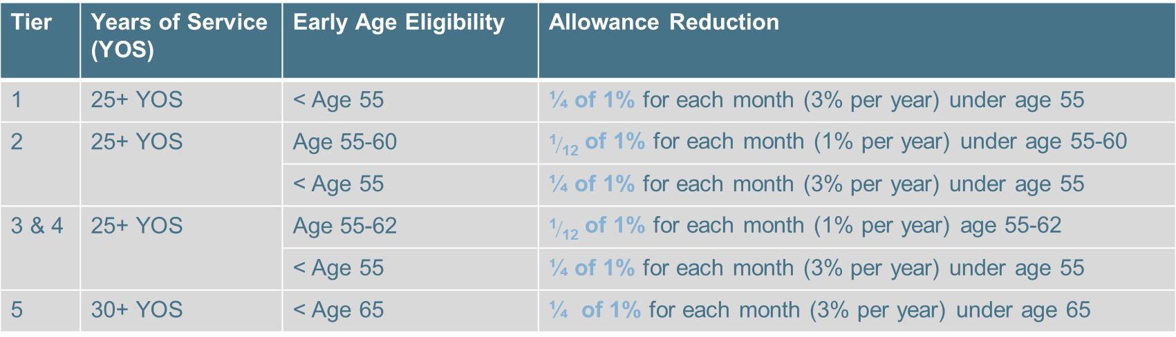
State Pension – New Jersey Teachers’ Pension and Annuity Fund
YOUR OPTIONS FOR RETIREMENT
Early Retirement Eligibility
Tier | Years of Service (YOS) | Early Age Eligibility | Allowance Reduction
1 | 25+ YOS | < Age 55 | ¼ of 1% for each month (3% per year) under age 55
2 | 25+ YOS | Age 55-60 | ${\text{1}}/{\text{12}}$ of 1% for each month (1% per year) under age 55-60
 |  | < Age 55 | ¼ of 1% for each month (3% per year) under age 55
3 & 4 | 25+ YOS | Age 55-62 | ${\text{1}}/{\text{12}}$ of 1% for each month (1% per year) age 55-62
 |  | < Age 55 | ¼ of 1% for each month (3% per year) under age 55
5 | 30+ YOS | < Age 65 | ¼ of 1% for each month (3% per year) under age 65
Source: TPAF Member Guidebook, June 2018 - https://www.state.nj.us/treasury/pensions/documents/guidebooks/tpafbook.pdf
Notes:
Available to members who have 25 years or more of pension membership service credit before reaching age 60 for Tier 1 and Tier 2 members, or before age 62 for Tier 3 and Tier 4 members; or with 30 years or more of pension membership service credit before age 65 for Tier 5 members.
The benefit is calculated using the appropriate Service Retirement formula; however, your allowance is permanently reduced if you retire prior to attaining certain ages as defined by your membership tier.

Slide 9
Social Security + State Pension
YOUR OPTIONS FOR RETIREMENT
Will social security and a state pension be enough?
Type of Benefit | Amount
Average annual Social Security benefit ¹ | $18,272
Average annual pension benefit ² | $40,175
Total | $58,447
You can’t control Social Security or state pension amounts.
You can’t control inflation or unexpected expenses.
1 Social Security, Research, Statistics, & Policy Analysis, Nov. 2020 https://www.ssa.gov/policy/docs/quickfacts/stat_snapshot/
2 What Is the Average Teacher Pension in My State? Jan. 2019
https://www.teacherpensions.org/blog/update-what-average-teacher-pension-my-state

Slide 10
Supplemental Savings
YOUR OPTIONS FOR RETIREMENT
How can you save more?
Can’t Control
Can Control
State Pension
Social Security
Personal Savings
403(b) account
IRAs
Other savings
Notes:
What else can you do to take control of your retirement picture?
There are many options, but all of them can help you take control of your retirement and allow you to plan your future and retire on your terms.
A 403(b) account and IRA accounts are two primary investment vehicles that allow you to save for retirement on a “pretax” basis.
So what is the best option for you?

Slide 11
Supplemental Savings
YOUR OPTIONS FOR RETIREMENT
Two ways to help you save for the future
Pretax
Contributions are made to an account BEFORE income taxes are calculated
After-tax
Contributions are made to an account
AFTER income taxes are calculated
Account | Contributions
403(b) | From your paycheck
IRA | On your own to an individual account
Account | Contributions
Bank savings account | On your own to individual account AND earnings are taxable
Roth 403(b) | From your paycheck
Roth IRA | On your own to individual account
Notes:
What’s the best way for you to save?
There are two BASIC ways to save:
Tax-deferred saving or PRETAX savings in a 403(b) or IRA may be a good idea for you. How does it work?
You save pretax now, and you pay your taxes on withdrawal at retirement. Basically, it means that you take your savings right off the top of your gross salary, and put it towards retirement. At retirement, as you withdraw it you’re taxed like it’s regular income.
There are limits though, to how much you can save in a year. For a 403(b) the current limit is $19,500, but for an IRA the limit is $6,000. I know that sounds like a lot, but remember it’s a maximum.
You can also save on an after-tax basis, in fact you may already be doing that today. Your money in a bank savings account or CD is “saved” in a taxable account. The downside is that any “interest” you earn is also taxable each and every year.
But a Roth account – an IRA or Roth 403(b) – are accounts that you can contribute to on an AFTER-TAX basis, but the difference is that ALL of you contributions AND EARNINGS are completely TAX-FREE at retirement.
Think about that for a moment … potentially you would NEVER have to pay income taxes on this money again.
Let’s take a look at an example

Slide 12
Supplemental Savings – Pretax vs. After-tax
YOUR OPTIONS FOR RETIREMENT
Sample Paycheck | After-tax | Pretax
Gross Income Per Pay Period | $1,000 | $1,000
Tax-deferred Contributions (403(b)/IRA) | $0 | $100
Current Taxable Salary | $1,000 | $900
Tax (at federal tax rate of 24%) | $240 | $216
Take Home Pay | $760 | $684
After-tax Contribution (savings account) | $100 | N/A
Net Take Home Pay | $660 | $684
Tax Savings | $0 | $24
This hypothetical tax-deferred investment does not reflect deduction of any fees associated with the investment product to which contributions are directed. It is important to note that while taxes on amounts invested in tax-deferred investment are deferred until withdrawn, withdrawals are subject to ordinary income tax and, if made prior to age 59½, may be subject to a 10% IRS penalty tax. Conversely, earnings from investments that do not offer tax deferral are taxed currently, and withdrawals from such an investment are not subject to the penalty tax.
Some situations such as your personal investment horizon and income tax brackets (both current and anticipated), changes in tax rates and tax treatment of investment earnings, and lower maximum tax rates on capital gains and dividends may impact the results of this comparison. Each person’s situation is different so these and other considerations must be taken into account when making an investment decision. For illustrative purposes a tax rate of 24% has been used; however, a person’s tax rate will likely change over time.
Notes:
Here’s a sample paycheck.
In this example we started at $1000 for easy calculations and we only looked at the Federal tax rate and we made an assumption of 24% (for most of you it will likely be slightly lower).
Your take home pay would be $760, but then you also place another $100 from your paycheck directly to a separate savings account (like your credit union account).
Your net pay is now $660.
In the after-tax column, we didn’t save anything in a retirement account – instead all of our savings is in a savings account – and remember all of the interest you earn is also taxable as well.
Let’s take a look a better way to save and move that $100 from your savings account into a 403(b) account.
We start with the same level of pay.
$100 is now in our 403(b) account (and remember that all of the interest or return you earn is also tax deferred, until you make a withdrawal).
Now look at your income tax. Since your contribution is now pretax, that lowers your taxable salary and now you’re paying less taxes. And NOW you have more take home pay – since you are saving on a pretax basis.
Any questions???? (check in with audience here)

Slide 13
Why it Matters
The importance of saving on your own

Slide 14


What will retirement look like?
WHY IT MATTERS
  THE AVERAGE U.S. WORKER RETIRES AT ³
  61
  ON AVERAGE, WE ARE LIVING LONGER ⁴
  MARRIED PEOPLE ARE LIVING EVEN LONGER ⁴
      1 in 2
      men will live to be 90
      1 in 2
      women will live to be 92
      1 in 2
      spouses will live to be 96
      1 in 4
      spouses will live to be 100
3 Gallup Poll – Social Series: Economy and Personal Finance, April 2-11, 2018
4 Annuity 2012 mortality table published by the Society of Actuaries, Base Year 2017

Slide 15




Retirement expenses could look different
WHY IT MATTERS
 | Annual Medical Costs ⁵ Today’s Cost: $12,052 In 20 Years: $37,839
 | New Car ⁷ Today’s Cost: $38,723 In 20 Years: $75,722
 | Annual Groceries ⁶ Today’s Cost: $8,971 In 20 Years: $17,543
 | Annual Long Term Care ⁸ Today’s Cost: $82,128 In 20 Years: $160,598
5 HealthView Services: 2019 Retirement Health Care Costs Data Report
6 USDA Food Plans: https://www.fns.usda.gov/cnpp/usda-food-plans-cost-food-reports-monthly-reports. An inflation rate of 3.41% was used to calculate future grocery costs, and is derived from historic consumer indexes.
7 https://mediaroom.kbb.com/2020-10-01-Average-New-Vehicle-Prices-Rise-2-5-Year-Over-Year-in-September-2020-Accordingto-Kelley-Blue-Book. An inflation rate of 3.41% was used to calculate future new car costs, and is derived from historic consumer indexes.
8 https://longtermcare.acl.gov/costs-how-to-pay/costs-of-care.html. Annual cost of semi-private room as of 07/23/20; an inflation rate of 3.41% was used to calculate future costs and is derived from historic consumer indexes.

Slide 16
How much will I need?
WHY IT MATTERS
Everyone’s retirement income needs are different, but on average, Social Security and a state pension are not enough to meet expenses.
Income
needed
How do you fill your income gap during retirement?
Income $
Retirement Age
Notes:
One thing I hear a lot from retirees is that they’re going to be just fine – they have a pension and Social Security to provide for retirement. As we’ve discussed, those two alone probably won’t replace all of your pre-retirement income.
Let’s use this graph to draw your income you need in retirement to meet your expenses.
Then at 60 you retire and start drawing a pension. Now your income is not quite where it was, and there’s a significant gap between your income and your expenses. You can’t draw Social Security until at least 62, or 67 for full benefits.
At 67, you’re finally ready to start drawing Social Security, but it’s now been 10 years since you had working income and things are much more expensive. How much extra does Social Security get you? Not much. And that’s all the Social Security you’ll ever get, it’s indexed to inflation which means it will never grow larger in real dollars.
So how can you fill the income gap during retirement?
Let’s take a look at your options.

Slide 17
How much will I need?
WHY IT MATTERS
403(b) accounts and IRAs can be used to:
Help you generate retirement income; or
Provide time for you to wait and maximize other sources of income
Income
needed
How do you fill your income gap during retirement?
Income $
Retirement Age

Slide 18
Saving on your own for retirement matters because it may be the only way to bridge the gap between what you have and what you need.

Slide 19
How much can I save?
WHY IT MATTERS
Time: Your most valuable asset. If you saved just $100 per paycheck, how much might you eventually accumulate? It’s never too early – or too late – to start saving for retirement.
Age to Begin Contributions
This illustration does not take into account the effect of any state or federal taxes. The performance of the investment, 6%, in the illustration is hypothetical and in no way relates to the actual or expected performance of any investment. The results of an investment may differ substantially. Investing involves risk and there is no guarantee of investment results. This illustration assumes $100 invested 20 times per year.
Account Value
Notes:
Now let’s take a look at what our $100 from each paycheck can do for your retirement picture.
Let me stress this is a hypothetical example, based on averages. Your result could be higher than this, or it could be lower.
If you were to start investing $100 at different stages of life, you could end up with different amounts at age 65. Sounds easy enough, right? If you start saving at 25 you’ll have more at retirement than if you start saving at 55. But just how much more may surprise you. For this graph, the dark blue is the actual amount you’ve contributed, and the light blue is your total account value.
If you start saving at 55, saving just $100 per paycheck, in 10 years you could accumulate $25,000.
If you start at 45, you could save almost $65,000!
If you start at 35, look at how much you could save! Over $126,000! And look at how much you contributed versus how much your account grew – the majority of that account value is coming from compounding, meaning that investing earlier really pays off.
But if you were to start at 25 Wow! You could have nearly $225,000! That would certainly help you toward a nice retirement. And almost all of that value comes from compounding, because you started investing early. That’s the moral of the story – it’s never too early or too later to start saving for retirement.
Again, you need to remember this is investing a total of just $100 per paycheck toward retirement. If you invested more, you could see even more growth than this.

Slide 20
Start saving early.
WHY IT MATTERS
Time: Your biggest advantage in retirement saving.
Contribution Per
Pay Period
Years to Retirement
This hypothetical demonstration assumes an 6% annual effective rate of return with ongoing contributions into a tax-deferred retirement account, and 20 pay periods per year. The above demonstration does not take into account the effect of any state or federal taxes. The performance of the investment is hypothetical and in no way relates to the actual or expected performance of any investment. The results of an investment may differ substantially. Investing involves risk and there is no guarantee of investment results.
Notes:
Starting your retirement savings early, even with a minimal investment, can have a big impact on how much you accumulate over time.
In tax-deferred saving, time is more important than your contribution amount. These examples demonstrate how different amounts can add up over the years.

Slide 21
The basics of tax-deferred saving
WHY IT MATTERS
Tax-deferred saving is available in a 403(b), 457 or IRA
Save pretax now, pay taxes on withdrawal at retirement
Depending on tax brackets, it might be like getting as much as 24% extra
for every dollar you save!
Acct. type | Annual Limit | Annual age 50 “Catch-up” | Total | Potential tax savings
403(b) | $19,500 | $6,500 | $26,000 | $6,240
457 | $19,500 | $6,500 | $26,000 | $6,240
IRA | $6,000 | $1,000 | $7,000 | $1,680
Assumes a federal tax rate of 24%
Notes:
To give you more flexibility, options and choices at retirement, you need to start saving and save as much as you can.
We believe that pretax savings is one of the best ways to help you save for retirement. It allows you to save money NOW and pay less taxes …
If you were to save the maximum – either in a 403(b) or IRA – you may be able to save as much as 24% in income taxes. In other words, for each dollar you save PRETAX may only cost you 76 cents.
And the impact can be monumental to your overall retirement picture.

Slide 22
How to Take Action

Slide 23

Early Career (working < 10 years)
HOW TO TAKE ACTION
TIME – YOUR MOST VALUABLE ASSET
Put retirement savings first; contribute money each and every pay period
Homes, cars and even college tuition can all be financed with loans – retirement can’t
Payroll deferrals make it easy
  Automatically deducted from your paycheck
  Can easily adjust contribution amount at any time
Notes:
All this sounds great, and I bet you’re thinking that if you only had the money to spare, you could certainly save a bundle for your retirement. Right? If we all were millionaires nobody would have retirement concerns, and we could all go home. But unfortunately, everyone thinks that way. That’s why it’s important to put your retirement savings first. Everyone thinks “I could save if I just had more money.” But if you had more money, you wouldn’t need to save. Right?
Think of it this way things like homes, cars, and even future kids’ college tuition can all be financed with loans or debt. Retirement can’t. You can’t take out a loan if you get to retirement and you find yourself coming up short. It’s important to save now, because what you save now will be your income one day. So you want to make sure you’re paying yourself enough to live on.
Things like payroll deferrals make this process easy. You can set up a payroll deferral to any employer sponsored account like a 403(b) or 457. It’s automatically deducted from your paycheck, meaning you don’t have to remember to contribute each month. You also never miss it, because it never goes into your bank account. A lot of people find it easier to contribute when they don’t have to see the money leave their account.
It’s also easy to adjust your contribution rate – most employers will allow you to adjust at any time, as often as you need, although it may take a pay cycle or two to take effect. Check with your employer for details. You can also “set it and forget it”. There may even be options for annual increases, to ensure that as you earn more money you are contributing a higher percentage of your salary.
So make sure you’re prioritizing savings. It will benefit you in the long run, for certain.

Slide 24

Mid Career (10-25 years)
HOW TO TAKE ACTION
ACCUMULATION PHASE
Review your savings plan. Has it kept up with:
  Job changes
  Annual raises
  Salary schedule changes
Review your pension benefit
Determine a strategy to take retirement income
Adjust your portfolio risk, if necessary

Slide 25
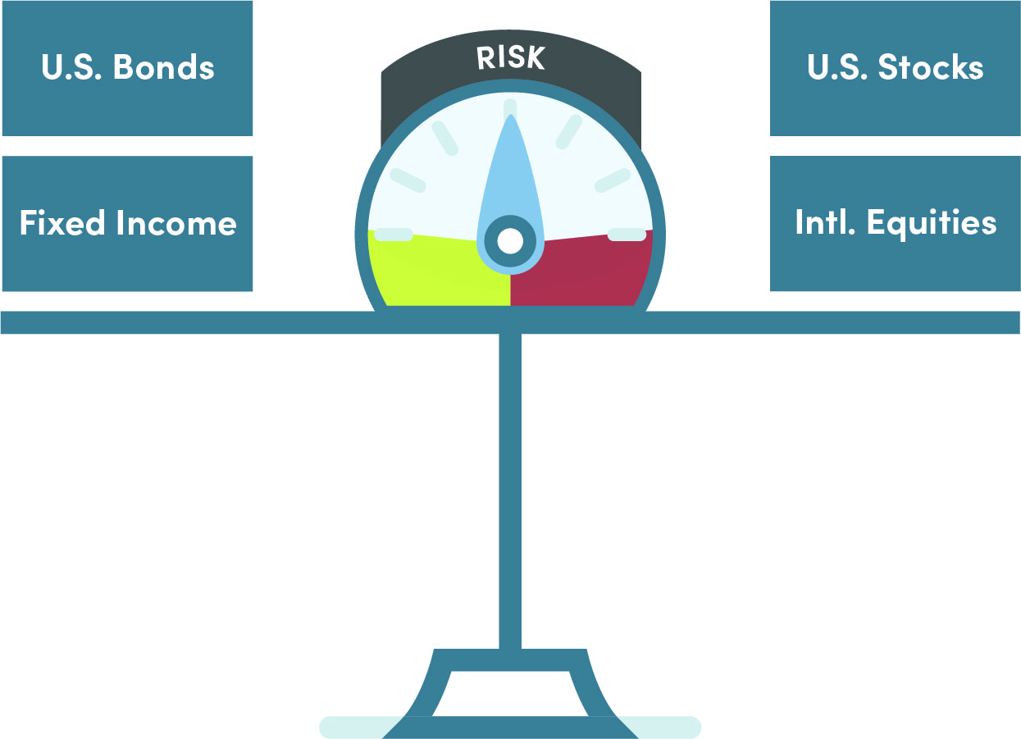
Balancing Risk
HOW TO TAKE ACTION
Those with more time before retirement,
or more appetite for risk, may choose
investments with higher returns
As you approach retirement, more
conservative investments may help
you mitigate loss
Remember that your account does not
automatically update for you!
Notes:
As you move throughout your career some of your strategy may involve more of a balance of risk. Don’t be afraid to ask questions about your investment strategy and review your investments with your financial professional at least once a year.
A mix of U.S. Stocks, International funds with US Bonds and Fixed Income can help you mitigate market pitfalls and downturns. You should feel comfortable with the strategy and the risk in your portfolio.

Slide 26

Late Career (Last 10 years)
HOW TO TAKE ACTION
BE READY FOR DISTRIBUTIONS
Review your savings plan, pension benefit and retirement income strategy
Adjust your portfolio risk, if necessary
Consider an estimated retirement date
Factor in the economic outlook
Ensure post-retirement budget is still appropriate

Slide 27

When do I need to decide to take benefits?
HOW TO TAKE ACTION
55
403(b) and other retirement plans allow penalty-free distributions when separated from service
59½
Standard age for penalty-free withdrawals from Traditional IRA accounts
  65
  Qualify for Medicare
72
Must begin taking withdrawals from tax-deferred accounts (RMD)
Age
50
55
60
65
70
75
62
May qualify for early Social Security Benefits (may be reduced by as much as 30%)
67
Full retirement age Social Security; multiple options:
Take benefits
Delay benefits until age 70
70
Delay taking Social Security Benefits until age 70; benefit may be up to 30% higher
Notes:
The first 10 years of your retirement are likely the most important in the rest of your life
When you decide to take benefits can dramatically affect your retirement picture Most of the decisions you make in the first few years of retirement – are often permanent and can’t be undone.
Age 55 is probably the earliest we see people retire from the education system. Most go back to work part-time at this point, but if you’ve had a 403(b) account you can actually begin taking distributions after you separate from service – without any penalty.
Otherwise, you may have to wait until age 59 and a half to take withdrawals from your IRA without penalty.
Age 62 – is a key milestone, not only is it the “Full Retirement Age” for many of you, it’s also the earliest you may qualify for Social Security, but if you begin taking benefits now – they will likely be 35% less than your full benefit for the rest of your life.
If you can wait until AGE 67 to take your benefit – you and your spouse may have even more options.
The year you turn 70 – is the year you’ll need to begin taking Social Security (if you haven’t already). Age 72 is the age that the Government mandates that you begin withdrawing at least a portion of your retirement assets out of your account. These are called Required minimum withdrawals or RMDs.
Your financial professional or tax consultant can help you plan these withdrawals from your investments once you reach age 70.

Slide 28
A checklist to get started
HOW TO TAKE ACTION
Review the plan options
  Register for your benefits with Member Benefits Online System (MBOS)
  https://www.state.nj.us/treasury/pensions/mbos-register.shtml
Determine the best way for you to save for today and for retirement
Start small – start now
Review your plans annually
Notes:
So what can you do NOW?
The best piece of guidance we can give you … is to start now, even if you think it’s only a small portion.
Your retirement picture is something that you should create and control. So here’s a few items to do to help you
GET STARTED.
Understand what your state pension benefit might look like.
You can and should register for your benefits.
Think about what is the best way for you to save for retirement – pretax or after-tax.
Even if you start out making small contributions – if you start now can make a BIG difference in your future.
I can also help you prepare a “paycheck analysis” to help determine how much they can save for retirement.

Slide 29




Tools available to you
HOW TO TAKE ACTION
 | Online Calculators What will my pension and/or social security benefit be?
 | Income Gap Report Are there any potential income gaps in your retirement plan?
 | Paycheck Analysis Report Think you can’t contribute more? Have your financial professional run a paycheck analysis report. You might be surprised.
 | Income and Spending Strategy How are you going to start taking income in retirement? Talk to your financial professional to develop a plan.
Notes:
Here are four tools you can use today to help you MOVE FORWARD along the path To and Through Retirement.
Review your benefits.
Pension and income analysis for when you want to retire.
Adjust your savings for the potential income you may need in retirement.
Balance your risk within your entire retirement and investment portfolio.
We can also help you take a quick look into what your future retirement benefits might be with a “Quick Gap” report that gives an estimate of your retirement benefits and how much income you may need from investments throughout retirement.

Slide 30
Summary
SECURITY BENEFIT FINANCIAL ESSENTIALS
Regardless of you career stage, you can take control of your
personal financial picture.
EARLY CAREER
Get started. Start to save now and leverage the power of tax-deferral accounts.
MID-CAREER
Move forward. Understand your pension benefit and adjust your strategy now to
reach your retirement goals.
LATE CAREER
Be ready. Develop a strategy to maximize your income to meet your ever changing needs throughout retirement.
Notes:
Thank you all today (tonight) for coming and attending our Financial Essentials workshop. We’d like to thank (mention any key representatives, school district administrators, etc.).
Regardless of where you are on your Career Path – you can take control of your financial picture.
If you’re just beginning a new career – the most important step you can take is to GET STARTED.
If you’re around the halfway point in your career … MOVE FORWARD and adjust your savings now to reach your goals.
And If Retirement is on YOUR horizon … BE READY and develop a plan to help you make the right decisions during the first 10 years of your retirement.
We appreciate your time today and if you have any questions please feel free to contact us.
We’ve also provide a feedback form and an interest card. Please take a moment to fill out the feedback form to let us know how we can improve the presentation. If you need help or have questions about your retirement plans or goals, you may fill out the interest card and detach it from the feedback form and return it to (whomever is collecting them).
Thank you!

Slide 31

Our Promise: Helping our clients To and Through Retirement®.
Our Mission: Since 1892, Security Benefit has believed everyone deserves an opportunity to achieve financial security. We deliver innovative retirement solutions to individuals and families across America to help them build strong futures now and for generations to come.

Slide 32
Thank you
[First Name][Last Name]
[Title]
—
First.Last@SecurityBenefit.com
xxx-xxx-xxxx

Slide 33
Neither Security Benefit Corporation nor its affiliates are fiduciaries. This information is general in nature and intended for use with the general public. For additional information, including any specific advice or recommendations, please visit with your financial professional.
Services are offered through Security Distributors, a subsidiary of Security Benefit Corporation (Security Benefit).

