Slide 1
Charting the Course Forward
SPECIAL UPDATE: SECURITY BENEFIT FINANCIAL ESSENTIALS
2021/01/15
WEBINAR EVENT FOR OUR CLIENTS
47-09420-00 | 2021/01/15
Notes:
Thank you for attending today’s Charting the Course Forward webinar that’s specifically designed and developed for you by Security Benefit .

Slide 2

Our Promise: Helping our clients To and Through Retirement®.
Our Mission: Since 1892, Security Benefit has believed everyone deserves an opportunity to achieve financial security. We deliver innovative retirement solutions to individuals and families across America to help them build strong futures now and for generations to come.

Slide 3
Agenda
CHARTING THE COURSE FORWARD
Economic Stimulus and Regulatory Changes
Stock Market Volatility
Moving Forward: What to do now
47-09420-00 | 2021/01/15

Slide 4
Economic Stimulus and
Regulatory Changes
47-09420-00 | 2021/01/15

Slide 5
Economic Stimulus and Regulatory Changes
CHARTING THE COURSE FORWARD
Coronavirus Aid, Relief, and Economic Security Act – CARES
How will the various stimulus programs and regulatory changes affect you?
Economic Impact Payments to Americans
Waiver of
Student Loan Payments
Your
Retirement
Account
47-09420-00 | 2021/01/15

Slide 6
Economic Stimulus and Regulatory Changes
CHARTING THE COURSE FORWARD
CARES Act: Economic Impact Payments
Round 1 – CARES Act, 2020
  Basic Provisions
    Single Filers – $1,200 payment with Adjusted Gross Income (AGI) up to $75,000;
    payment is prorated for AGI between $75,000 and $99,000.
    No payment for AGI over $99,000
    Joint Filers – may receive up to a $2,400 payment with AGI up to $150,000;
    payments are prorated for AGI between $150,000 and $198,000 No payment for AGI over $198,000
    Children – $500 additional payment for each child age 16 and under in the family
  How Payments Were Calculated
    2019 – Federal tax returns/AGI
    2018 – Federal tax returns/AGI
47-09420-00 | 2021/01/15

Slide 7
Economic Stimulus and Regulatory Changes
CHARTING THE COURSE FORWARD
CARES Act: Economic Impact Payments
Round 2 – Consolidated Appropriations Act, 2021
  Basic Provisions
    Single Filers – $600 payment with Adjusted Gross Income (AGI) up to $75,000;
    payment is prorated for AGI between $75,000 and $99,000.
    No payment for AGI over $99,000
    Joint Filers – may receive up to a $1,200 payment with AGI up to $150,000;
    payments are prorated for AGI between $150,000 and $198,000 No payment for AGI over $198,000
    Children – $600 additional payment for each child age 16 and under in the family
  How Payments Are Calculated
    2020 – Federal tax returns/AGI
47-09420-00 | 2021/01/15

Slide 8
Economic Stimulus and Regulatory Changes
CHARTING THE COURSE FORWARD
Tips
www.irs.gov/coronavirus/
economic-impact-payments
Check Payment Status
Update address information
Bank account information
Estimate Your Payment
www.Kiplinger.com
– search “Stimulus Check Calculator”
CARES Act: Economic Impact Payments
How will you receive your payment?
  Generally, funds will be deposited to the bank account from your most recent tax refund
  IRS has established a website for you to update your payment information
  If you did not file your taxes in 2018 or 2019, you may register for your payment on the IRS website.
  If you or your spouse already receive Social Security, disability or survivor benefits, the IRS already has your information on file.
47-09420-00 | 2021/01/15

Slide 9
Stock Market Volatility
47-09420-00 | 2021/01/15

Slide 10
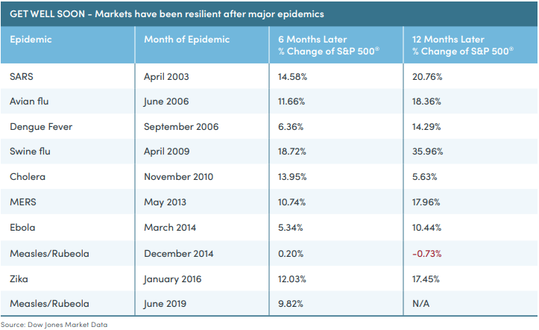
Stock Market Volatility
CHARTING THE COURSE FORWARD
Get Well Soon
History shows that markets have been
resilient after major epidemics
Reported March 24, 2020 at: www.marketwatch.com/story/heres-how-the-stock-market-has-performed-during-past-viral-outbreaks-as-chinas-coronavirus-spreads-2020-01-22
47-09420-00 | 2021/01/15

Slide 11
Recent Market Volatility
CHARTING THE COURSE FORWARD
RECENT HISTORY – WORST MONTHLY S&P 500®
MARKET PERFORMANCE
Monthly Market Down Turns
and Comebacks
Recent History
Several months have shown market drops
of more than 10%
In many cases, the market makes a comeback years after a one month negative return
During uncertainty, staying the course
has paid off for investors
Month / Year | One Month Return | 1 Year Later | 3 Years Later | 5 Years Later
November 1973 | -11.39% | -27.08% | 6.40% | -1.31%
September 1974 | -11.93% | 32.00% | 51.92% | 72.05%
October 1987 | -21.76% | 10.79% | 20.74% | 66.28%
August 1998 | -14.58% | 37.93% | 18.42% | 5.30%
September 2002 | -11.00% | 22.16% | 50.72% | 87.27%
October 2008 | -16.94% | 6.96% | 29.37% | 81.32%
February 2009 | -10.99% | 50.25% | 85.78% | 152.95%
February 2020 | -8.41% | -- | -- | --
March 2020 | -8.84% | -- | -- | --
Source: Morningstar Direct.
The performance data quoted represents past performance. Past performance is no guarantee of future results.
47-09420-00 | 2021/01/15

Slide 12
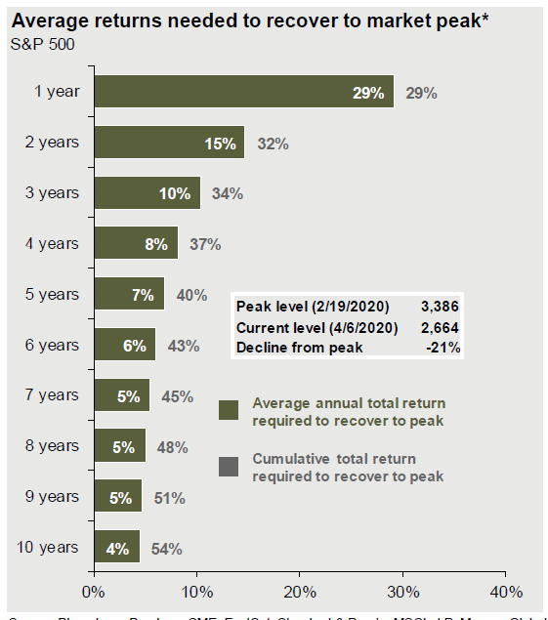
Recent Market Volatility
CHARTING THE COURSE FORWARD
How long will it take to “make it back”
Market Returns
The S&P 500 has averaged 10.24% return
since 1957 (when the S&P 500 began)
6.2% since 2000
13.6% since 2010
To reach the previous “high point”,
market would need to return 29% within
the next year
Source: J.P. Morgan Asset Management, Guide to the Markets, 2Q 2020, page 64. Data is as of April 6, 2020.
47-09420-00 | 2021/01/15

Slide 13
Moving Forward
47-09420-00 | 2021/01/15

Slide 14
Moving Forward: Make Market Volatility Work for You
S&P 500® Market Performance: 1989 – March 31, 2020
CHARTING THE COURSE FORWARD
Dec. 31, 2019
S&P closed at 3230.78
Dec. 31, 2014
S&P closed above 2,000 for the first time
Jan. 14, 2000
Peak value
of 1465.15
Oct. 9, 2007
End of 2000 Bull market 1565.15
Mar. 31, 2020
COVID-19
Outbreak
S&P closed at 2584.59
1995–1997
Beginning of the dot-com bubble
March 9, 2009
A 57% decline in the peak S&P from the peak of the housing bubble
Oct. 9, 2002
A 47% decline in the S&P from the peak of the dot-com bubble
source: finance.yahoo.com
47-09420-00 | 2021/01/15

Slide 15
Moving Forward: What to do now
CHARTING THE COURSE FORWARD
How can you take advantage of market volatility?
Dollar Cost Averaging*
example
Smaller equal investments over time
Allows you to purchase at lows and highs to average out overall costs
Take advantage of “swings” within the market
Cost
Per
Share
month
After 12 months
$1,200 total amount invested
126.20 shares purchased
$1262 total value
Invest $100 each month
at higher and lower amounts
Example above is hypothetical and is not representative of any specific investment.
47-09420-00 | 2021/01/15

Slide 16
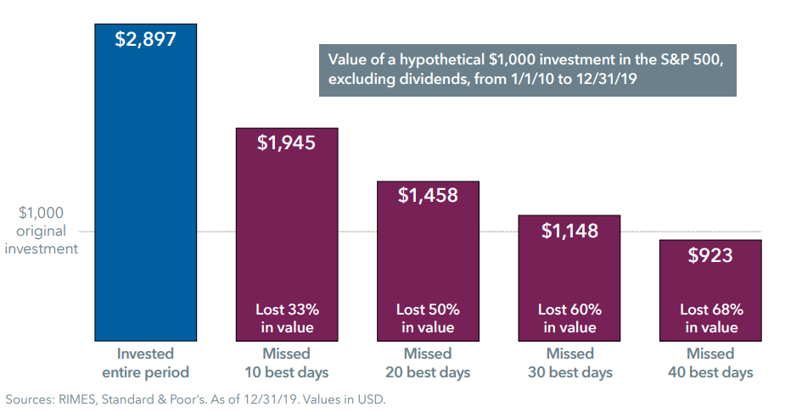
Moving Forward: What to do now
CHARTING THE COURSE FORWARD
Time in the market not timing the market
Missing out just a few days can dampen your returns
Courtesy of Capital Group, American Funds
47-09420-00 | 2021/01/15

Slide 17
Moving Forward: What to do now
CHARTING THE COURSE FORWARD
What can you do now?
Consumers have a unique opportunity to continue to save into their retirement plans – continue to invest at market lows
Stay the Course – continue along your path to achieve financial security
Dollar Cost Average – continue your contributions
Time In the Market – don’t “time” the market
Review your portfolio and your beneficiaries on your retirement account
47-09420-00 | 2021/01/15

Slide 18
Thank you
[First Name][Last Name]
[Title]
—
First.Last@SecurityBenefit.com
xxx-xxx-xxxx
47-09420-00 | 2021/01/15

Slide 19
Neither Security Benefit Corporation nor its affiliates are fiduciaries. This information is general in nature and intended for use with the general public. For additional information, including any specific advice or recommendations, please visit with your financial professional.
Dollar Cost Averaging does not assure a profit and does not protect against loss in a declining market. An investor should consider the ability to continue purchasing through periods of low price levels.
Services are offered through Security Distributors, a subsidiary of Security Benefit Corporation (Security Benefit).
47-09420-00 | 2021/01/15

